Slide 1
Sprint 4 Review
CB06 - group 4
Emanuil Karapachov
Bojidar Balabanov
Vlad Cojocariu
Mila Marinova
Wondimu Woldeaarggiye

Slide 2
Agenda
Sprint planning vs execution
Extended Connectivity between backend and frontend
Project Security
Planning for the final sprint
Questions

Slide 3
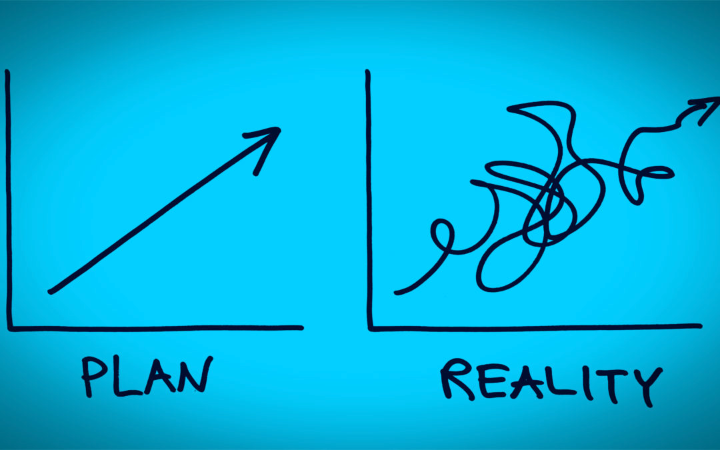
Sprint planning vs execution

Slide 4
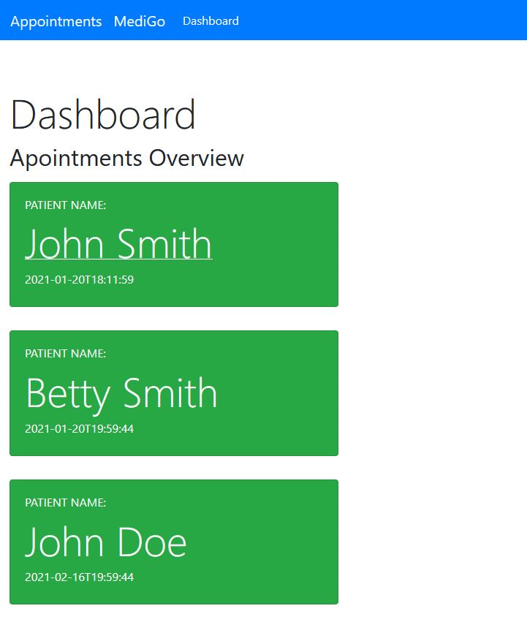
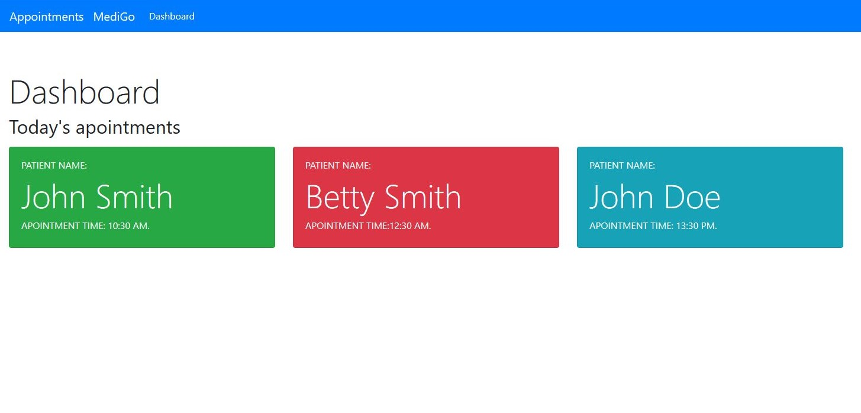
Extended Connectivity between backend and frontend

Slide 5

Security System

Slide 6
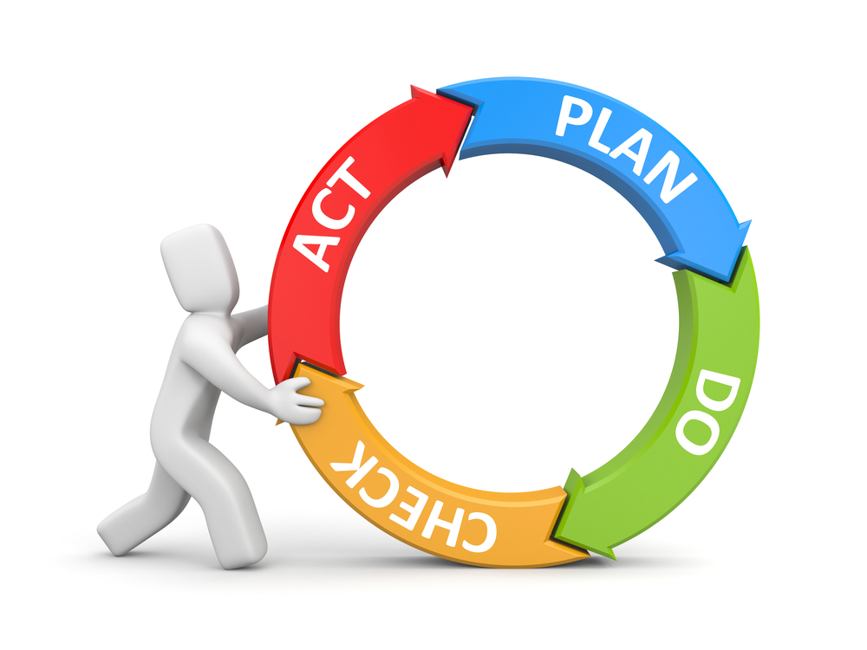
Planning for the next sprint

Slide 7

Questions

